Slide 1
Employee Data Analysis using Excel
STUDENT NAME: DURGA SRI VANI.L
REGISTER NO: 48EA5CF213468F69359416BAB85B8774,312208667
DEPARTMENT: B.COM (GENERAL)
COLLEGE: MEENAKSHI COLLEGE FOR WOMEN

Slide 2
PROJECT TITLE
Employee Analysis Based on Specific Department

Slide 3


AGENDA
Problem Statement
Project Overview
End Users
Our Solution and Proposition
Dataset Description
Modelling Approach
Results and Discussion
Conclusion
3/21/2024 Annual Review

Slide 4

PROBLEM STATEMENT
The Purpose of Employee Analysis Based on Specific Department is to analyze the underlying factors contributing to various issues and identify actionable solutions to enhance employee retention and improve overall department performance.

Slide 5

PROJECT OVERVIEW
This project is to analyze employee data within a specific department to gain insights into various factors such as performance, productivity, employee satisfaction, and retention rates. The analysis will help in identifying trends, making informed decisions, and improving overall departmental efficiency.

Slide 6

WHO ARE THE END USERS?
HUMAN RESORCE DEPARTMENTS
MANAGEMENT AND LEADERSHIP
TEAM LEADERS AND SUPERVISORS
EMPLOYEES
EXECUTIVE LEADERSHIP
BUSINESS ANALYSIS
RECRUITERS

Slide 7

OUR SOLUTION AND ITS VALUE PROPOSITION
FILTERING - REMOVE VALUES
PIVOT TABLE - SUMMARY OF EMPLOYEE
PERFORMANCE
BAR DIAGRAM - FINAL REPORT

Slide 8
Dataset Description
EMPLOYEE DATASET - KAGGLE
9 FEATURES IN EXCEL :
EMPLOYEE ID - ALPHANUMERIC(TEXT)
NAME - ALPHABETICAL(TEXT)
GENDER- ALPHABETICAL(TEXT)
DEPARTMENT - ALPHABETICAL(TEXT)
SALARY - NUMERICAL
START DATE - ALPHANUMERIC(TEXT)
FTE - NUMERICAL
EMPLOYEE TYPE- ALPHABETICAL(TEXT)
EMPLOYEE LOCATION- ALPHABETICAL(TEXT)
3 FEATURES USED :
DEPARTMENT - ALPHABETICAL(TEXT)
FTE - NUMERICAL
EMPLOYEE TYPE - ALPHABETICAL(TEXT)

Slide 9

THE "WOW" IN OUR SOLUTION
Create a dynamic, real-time platform that integrates employee feedback, performance data, and engagement metrics.
Tailor employee engagement and development programs to individual needs and preferences.
Enhance how feedback is gathered and acted upon using modern, engaging methods.
3/21/2024 Annual Review
9

Slide 10
MODELLING
● STEP - 1
DOWNLOAD THE EMPLOYEE DATASET AND OPEN THE EMPLOYEE DATASET IN EXCEL.
● STEP -2
SELECT THE ENTIRE DATA AND CLICK ON DATA AND CLICK ON FILTER OPTION.
● STEP -3
FILTER FTP FROM A TO Z ORDER.
● STEP -4
SELECT THE ENTIRE DATA AND CLICK ON INSERT AND CLICK ON PIVOT TABLE TO CREATE PIVOT TABLE.
10

Slide 11
● STEP -5 DRAG THE NEEDED DATA AND CREATE A PIVOT TABLE. ● STEP -6 SELECT THE PIVOT TABLE AND CLICK ON INSERT. ● STEP-7 NOW CLICK ON THE CHART THAT YOU WANT. ● STEP -8 THE CHART IS CREATED. ● STEP -8 THE CHART IS CREATED.

Slide 12
RESULTS
1. TABLE
Sum of FTE Row Lables | Column Lables Accounting | Business Development | Engineering | Human Resources | Marketing | Grand Total
Fixed Term | 4 | 4 | 1.8 | 3.4 | 0.3 | 13.5
Permanent | 10.8 | 13.9 | 6 | 4.7 | 7.5 | 42.9
Temporary | 1.6 | 2 | 4 | 1.8 | 0.8 | 10.2
Grand Total | 16.4 | 19.9 | 11.8 | 9.9 | 8.6 | 66.6
12

Slide 13
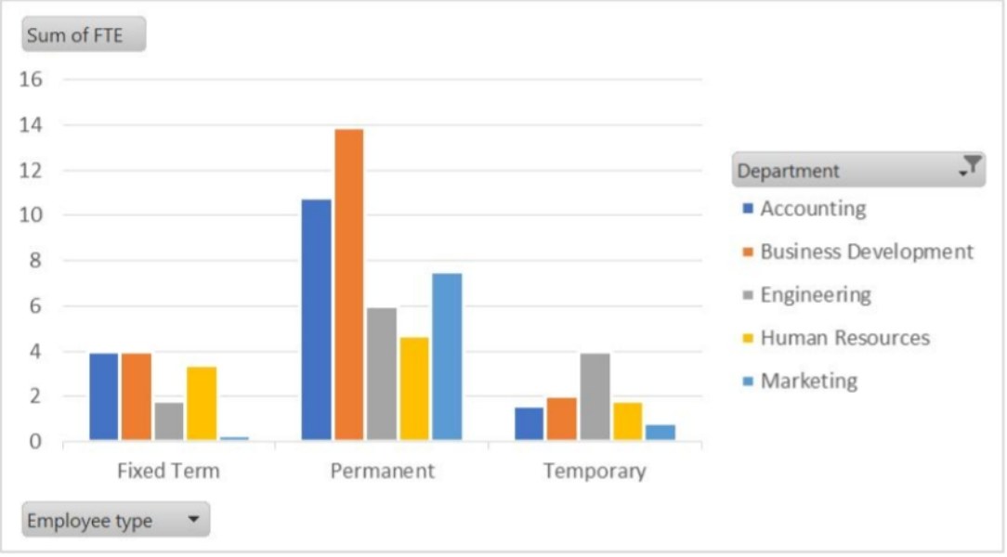
2. BAR DIAGRAM

Slide 14
Conclusion
The analysis of employee data using Excel has proven to be a powerful approach for gaining valuable insights into workforce dynamics and operational efficiency.
Through effective use of Excel’s data management tools and analytical functions, we were able to identify key trends, such as patterns in employee performance, attendance rates, and compensation structures.

